Slide 1

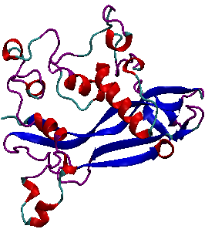
BT5420
Computer Simulations of Biomolecular Systems
Project Presentation
In silico analysis of the V66M variant of human BDNF in psychiatric disorders
De Oliveira, Clara Carolina Silva et al. doi:10.1371/journal.pone.0215508
Sahana Gangadharan | BE17B038 | be17b038@smail.iitm.ac.in

Slide 2
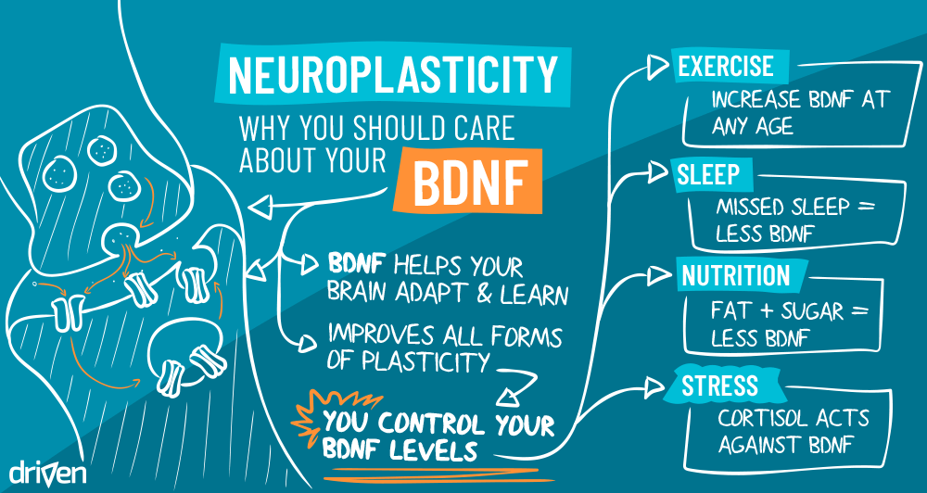
INTRODUCTION
BDNF – 247 residues long; r136 – r244: 1BND
BDNF_V66M – missense mutation; pro-region of the protein
BDNF_V66M – impairs protein function & distribution
BDNF_V66M – associated with psychiatric disorders
Generate structure of BDNF
Validate the structure
Predict SS of BDNF*
Perform phylogenetic analysis
Molecular Dynamic Simulations
MD Analyses – RMSD
MD Analyses – B-factor*
MD Analyses - RMSF
MD Analyses – PCA – ED*
MD Analyses – Rg
MD Analyses – SASA
Analysis of SS patterns @ V66M*
Hydrogen bond occupancy
Workflow of steps

Slide 3
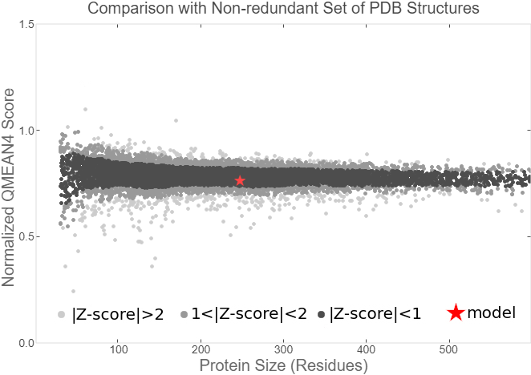
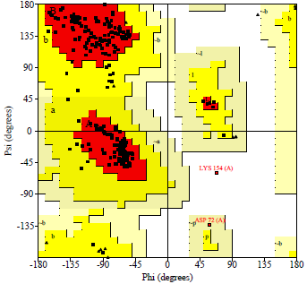
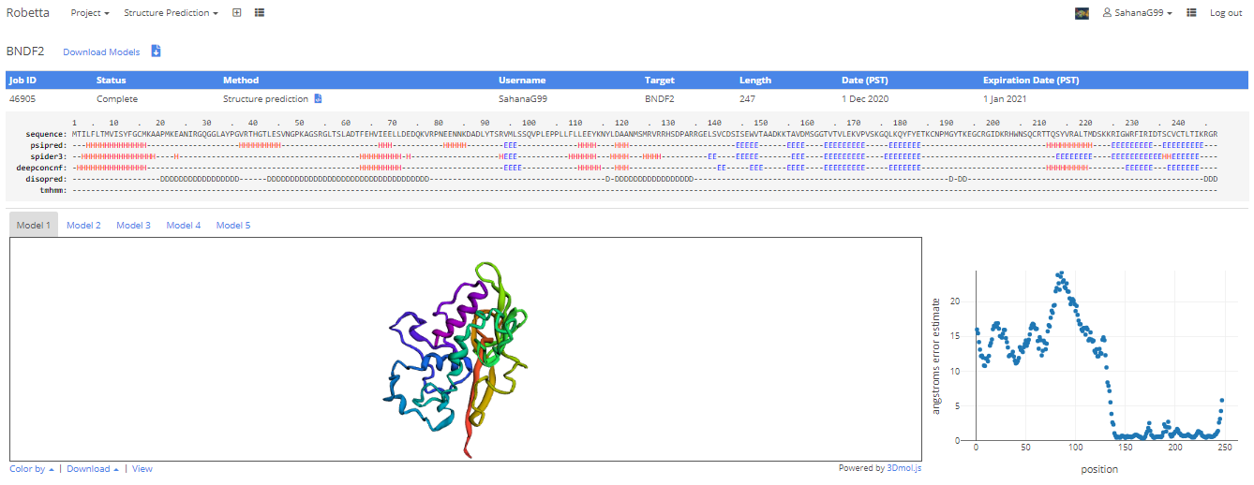
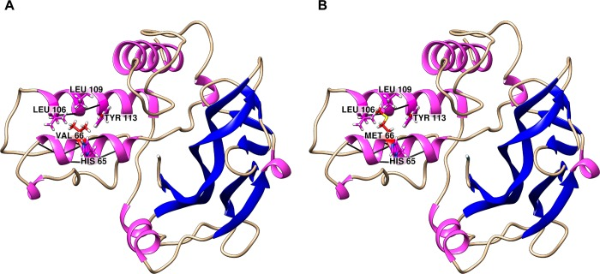
GENERATION & VALIDATION OF 3D STRUCTURES
Generation of BDNF structure
Validation of BDNF structure
Submit sequence of BDNF from UNIPROT to Rosetta server.
QMEAN – quality based on physiochemical properties
PROCHECK – stereochemical quality & plots Ramachandran plot.
(i) BDNF & (ii) BDNF_V66M structure
Submit generated structure & 1BND to TM-Align - RMSD of 1.07 A* and TM-Score of 0.93933
Generation of V66M BDNF structure
1. Generate PSF file using Automatic PSF Builder in VMD application
2. Induce V66M mutation using Mutator Plugin in VMD application

Slide 4
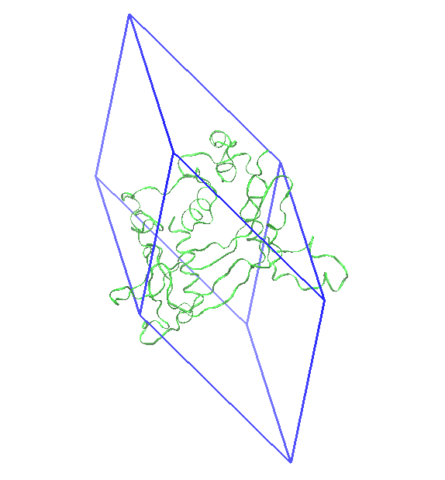
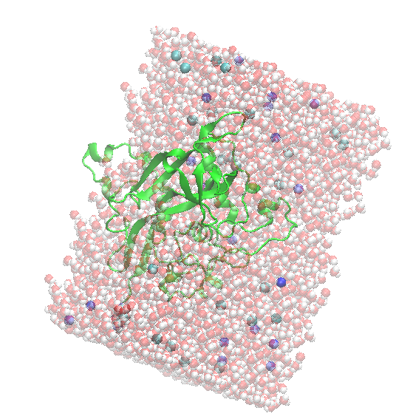
SIMULATION DETAILS
Force field
AMBER99SB-ILDN
Water model for solvation
Explicit TIP3P water model; 1 nm padding
PBC box
Dodecahedron box (5.50 *8.27*4.56 nm)
Salt concentration for neutralization
0.15 mol/L – 19 (93) Na+ and 26 (96) Cl- ions were added
Minimization of systems
Steepest descent method
NVT simulation
NPT simulation
Temperature - 300 K, Duration - 100 ps
Barostat - Parrinello-Rahman; Thermostat – v-rescale
Temperature - 300 K, Pressure – 1 atm, Duration - 100 ps
Barostat - Parrinello-Rahman; Thermostat – v-rescale
MD simulation
No position restraint; LINCS – constraining covalent bonds; PME method – processing electrostatic interactions
Temperature – 300 K, Duration – 1 ns (200 ns).
Trajectories recorded every 10 ps.
Barostat - Parrinello-Rahman; Thermostat – v-rescale
Trajectory correction to remove PBC box
gmx trjconv -f md.xtc -o md_nopbc.xtc -s md.tpr -pbc mol -ur compact
BDNF protein in a
dodecahedron box
BDNF protein after
solvation and neutralization

Slide 5
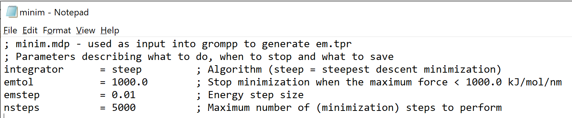
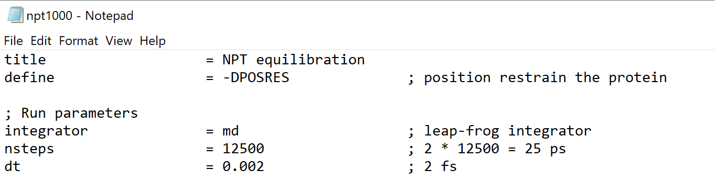
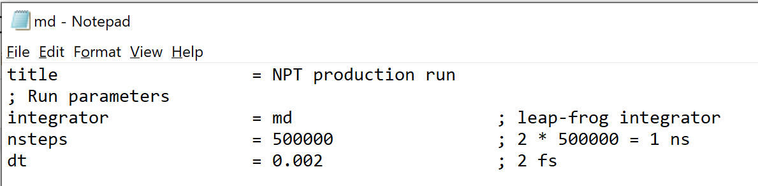
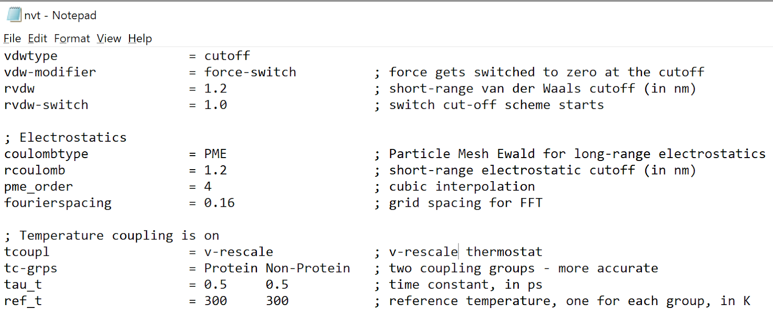
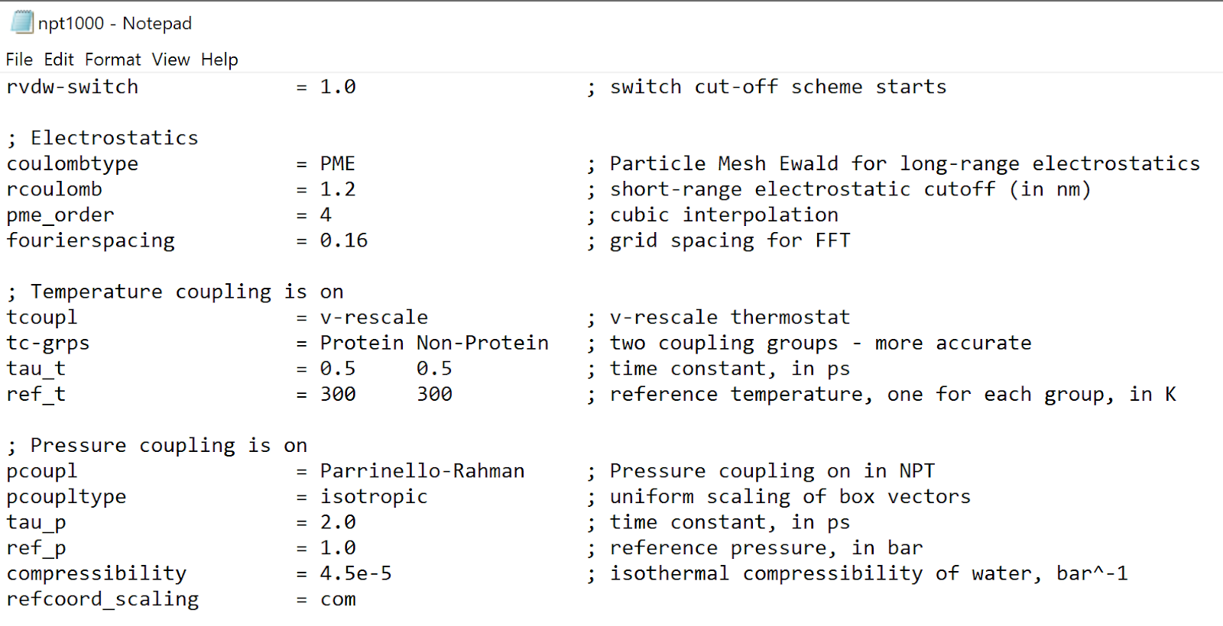
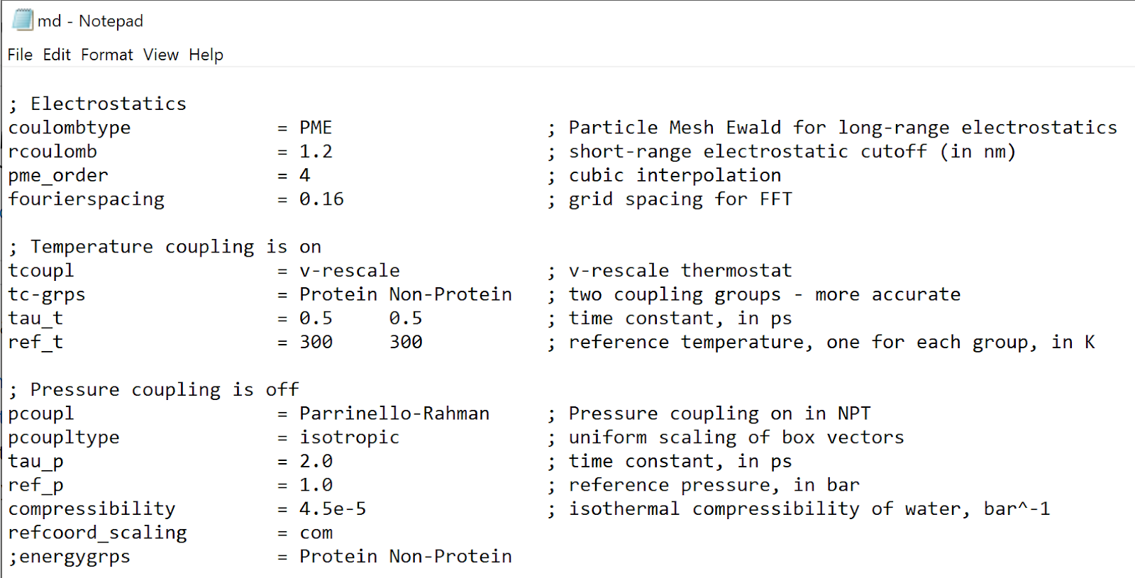
MODIFICATIONS TO *.MDP FILES
minim.mdp
npt.mdp
md.mdp
Modified total number of steps
Modified total number of steps
Modified total number of steps
nvt.mdp
npt.mdp
md.mdp
Changed thermostat to v-rescale
Changed thermostat to v-rescale
Changed thermostat to v-rescale

Slide 6
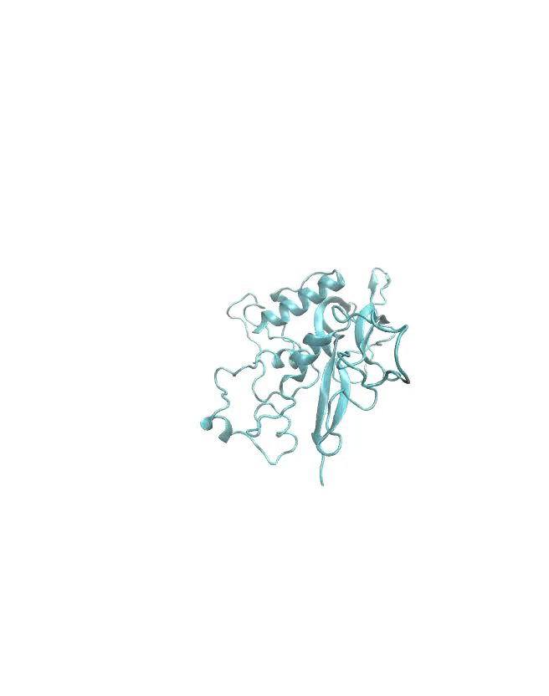
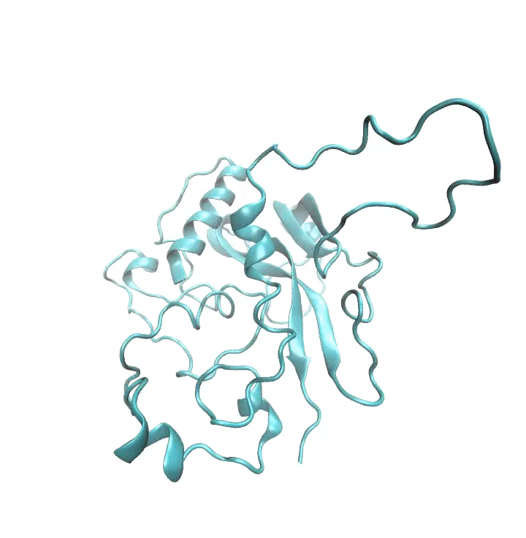
MD PRODUCTION SIMULATION
BDNF – 1 ns
BDNF_V66M – 1 ns
10 frame video

Slide 7
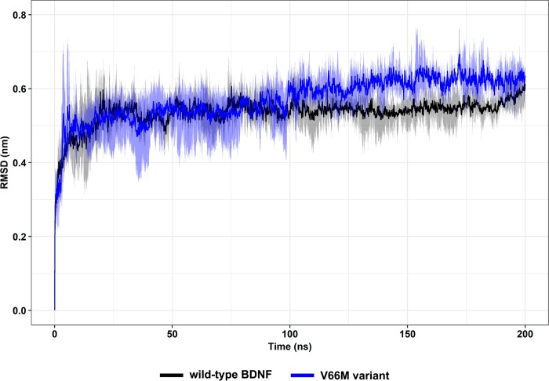
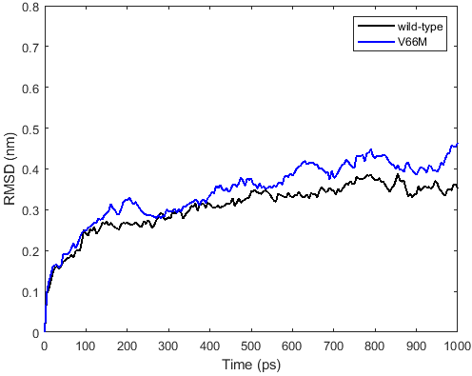
ROOT MEAN SQUARE DEVIATION (RMSD)
COMMAND - gmx rms -f md_nopbc.xtc -s md.tpr -o rmsd.xvg – Backbone for least square fit calculations and Protein for RMSD calculation

Slide 8
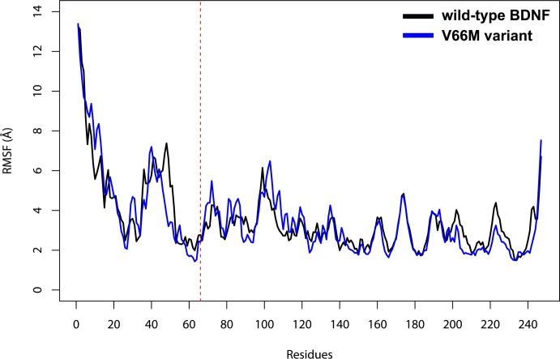
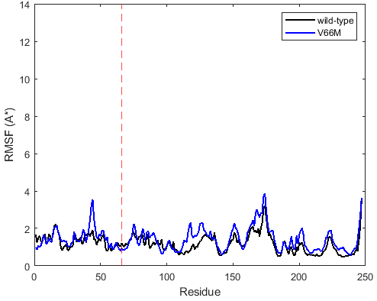
ROOT MEAN SQUARE FLUCTUATION (RMSF)
COMMAND - gmx rms -f md_nopbc.xtc -s md.tpr -o rmsd.xvg
C-alpha for RMSF calculation
Proof

Slide 9
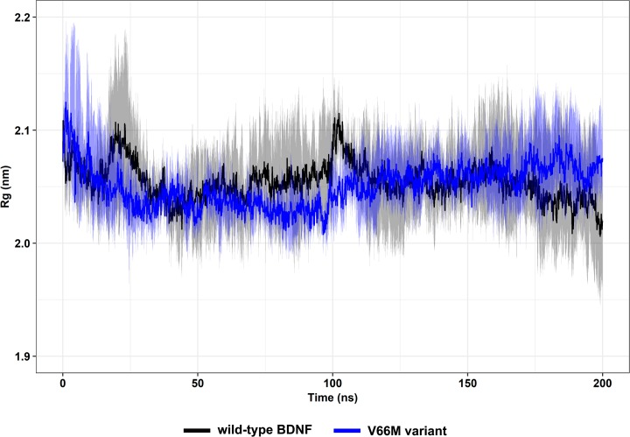
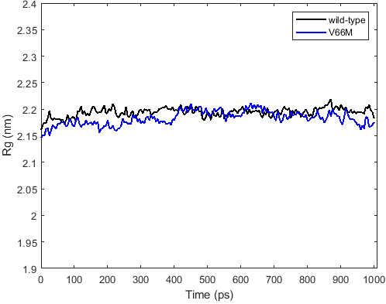
RADIUS OF GYRATION (RG)
COMMAND - gmx gyrate -f md_nopbc.xtc -s md.tpr -o gyrate.xvg
Protein for Rg calculation

Slide 10
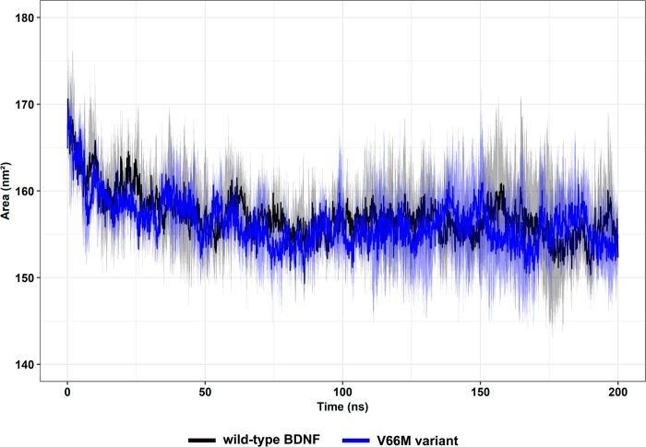
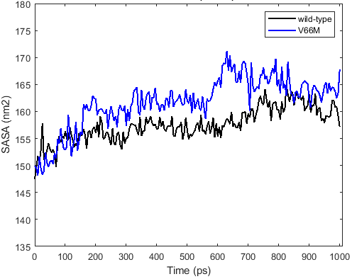
SOLVENT ACCESSIBLE SURFACE AREA (SASA)
COMMAND - gmx sasa -f md_nopbc.xtc -s md.tpr -o area.xvg
Protein for (output) SASA calculation

Slide 11
ACKNOWLEDGEMENTS
I thank the course faculty Dr. Hamsa Priya Mohana Sundaram, for her valuable inputs throughout the course and for making this a very fun learning experience.
I thank my classmates (Special mentions to Sankalpa, Sathvik, Mugdha, Srivarshini, Gayathri and Neha) for all the meaningful discussions.
Special thanks to GROMACS for valuable life lessons throughout the project!
GROMACS reminds you: "A real scientist solves problems, not wails that they are unsolvable."
GROMACS reminds you: "Science and everyday life cannot and should not be separated."
GROMACS reminds you: "If it weren't for bad luck, we'd have no luck at all"
GROMACS reminds you: "Somewhere, something incredible is waiting to be known."
GROMACS reminds you: "Life need not be easy, provided only that it is not empty."

Slide 12
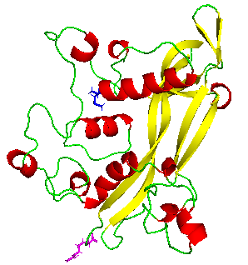
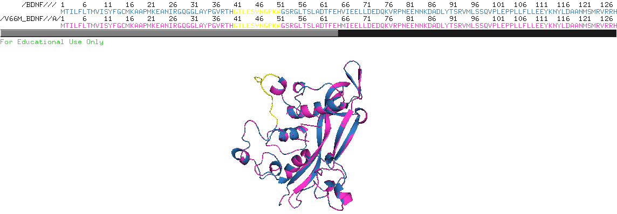
Supplementary Information - RMSF
N terminus is buried inside the 3D structure, while the C terminus is outside
The secondary structure of the WT and V66M variants of BDNF across residues 40 - 50, correspond to loop regions.
Back to slide

Slide 13
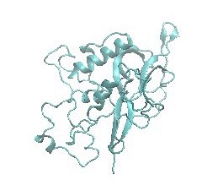
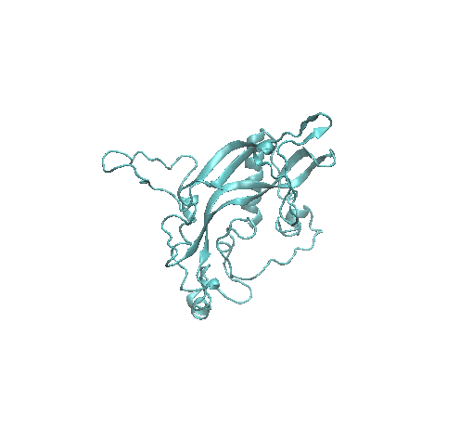
Supplementary - MD PRODUCTION SIMULATION
BDNF – 1 ns
BDNF_V66M – 1 ns
Back to slide

